Slide 1












Slide 13


Slide 14




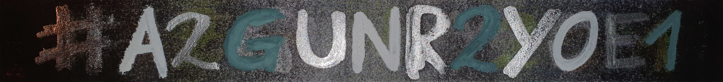

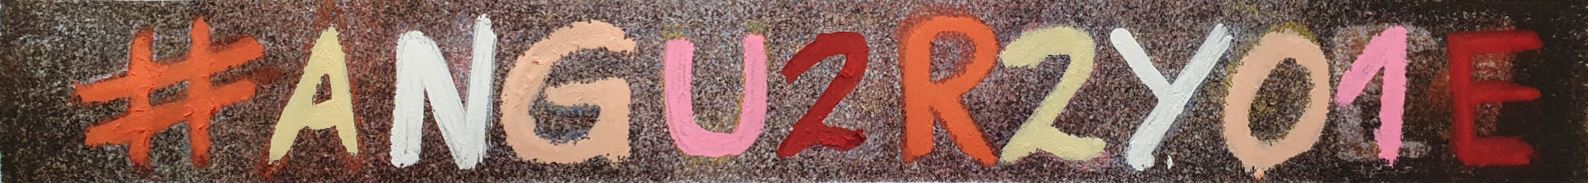
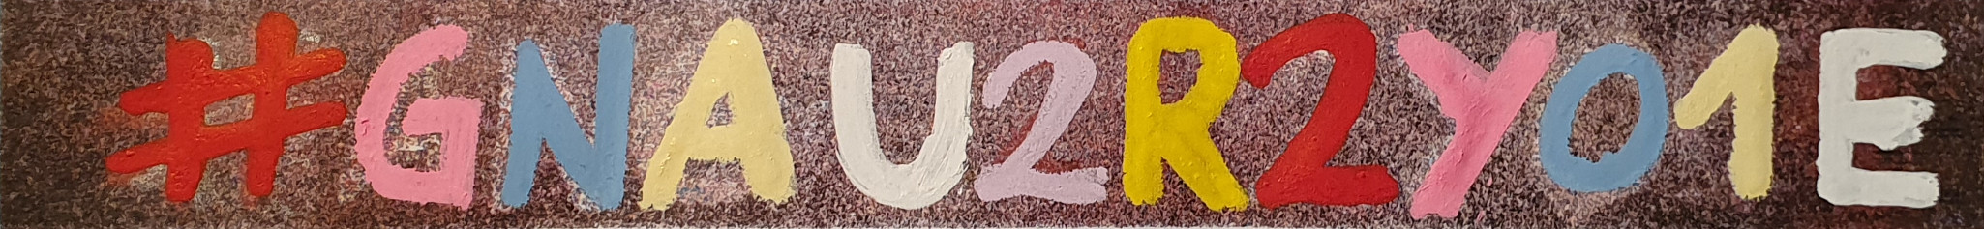

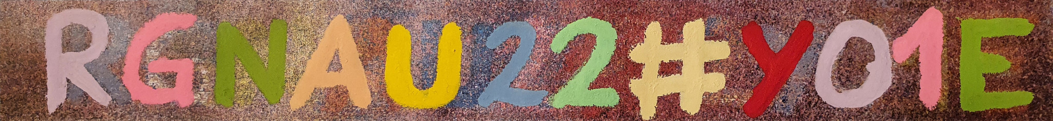
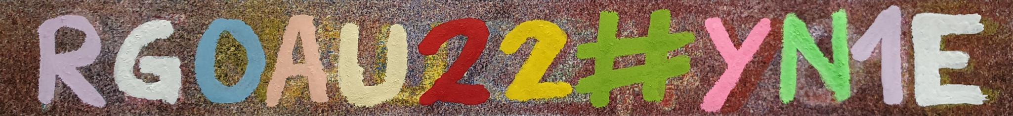

Slide 15
#genuary2021
#neguary2021
#aegunry2021
#a2gunry20e1
#a2gunr2y0e1
#angu2r2y0e1
#angu2r2y01e
#gnau2r2y01e
rgnau2#2y01e
rgnau22#y01e
rg0au22#yn1e
r20aug2#yn1e
r202uga#yn1e
r202u#agyn1e

